Slide 1
PREDICTION OF WHO SHOULD REFACTOR THE CODE
S. BENDAPUDI, R. KIPP, T. OLATUNBOSUN, and M. SZCZEPANIAK

Slide 2
TABLE OF CONTENTS
01
02
03
PROBLEM & SOLUTION
OUR PROCESS
TARGET
What Refactoring is? Who usually performs Refactoring?
How we’re tackling the problem
The results we’ve seen and are trying to improve

Slide 3
OUR PROBLEM
Multiple developers work on and maintain a codebase
The request is assigned to a developer skilled in the type of refactoring needed and the area of the project in which the refactoring is needed
Established Project
Refactoring Triage
Refactoring Request
Refactoring Complete
Something is noticed that needs to be rewritten in order to improve the readability, usability, and functionality of the codebase
The refactoring is completed by the developer, reviewed and then it is either accepted or reworked

Slide 4
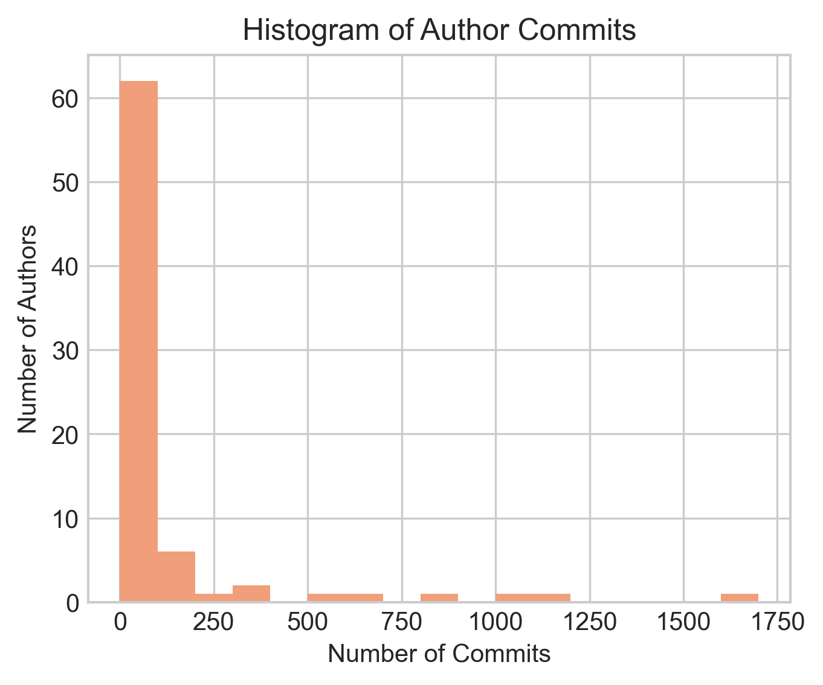
UNDERSTANDING THE PROBLEM
Multiple Developers
There are a few developers with a large number of commits, and a large number of developers with a few commits. This large inequality creates imbalanced groups and complicates our problem

Slide 5
UNDERSTANDING THE PROBLEM
Move Class, Rename Attribute, Rename Method, Extract Method, Inline Method, Rename Parameter, Extract Variable, Rename Variable, Extract Superclass, Move Method, Extract And Move Method, Parameterize Variable, Extract Subclass, Push Down Attribute, Push Down Method, Extract Class, Move Attribute, Move And Rename Class, Inline Variable, Rename Class, Pull Up Method, Replace Variable With Attribute, Move Source Folder, Pull Up Attribute, Extract Interface, Move And Rename Attribute, Change Package
Variety of Refactoring Types
There are a 27 different refactoring types. The expectation would be that certain developers are better at some than others and visa versa. The type of refactoring that is needed is determined in the refactoring request, allowing us to use this information as part of our feature set.

Slide 6
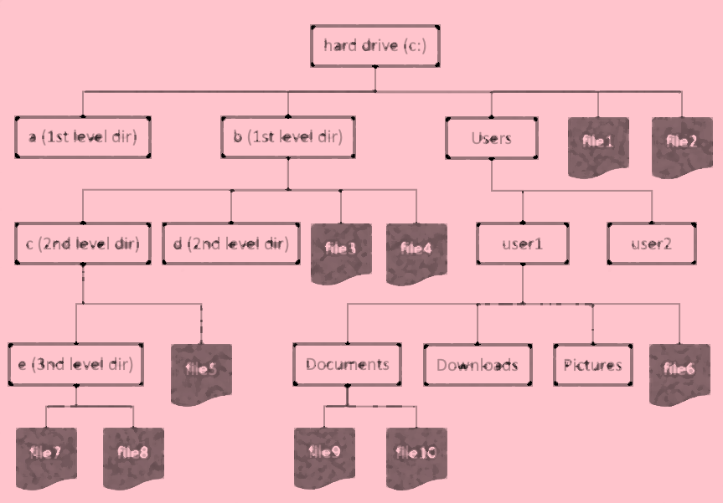
UNDERSTANDING THE PROBLEM
Large File Structure
The file structure of any codebase is complex. Different areas usually correspond to different features or different parts of the program (i.e. frontend, backend, tests, etc). The assumption that different developers will be more familiar with different aspects of the project allows us to use the file structure as an input as well.

Slide 7
OUR RESEARCH QUESTIONS
RQ1
RQ3
Which of the three classification model tends to give the lowest classification error?
Which features are most important in predicting which developer is best suited for a given refactoring request?
RQ2
What is the trade-off in overall model performance if improved performance of the low committer group is a priority?

Slide 8
We will explore these questions using data from the adangel/PMD and hibernate open-source projects

Slide 9
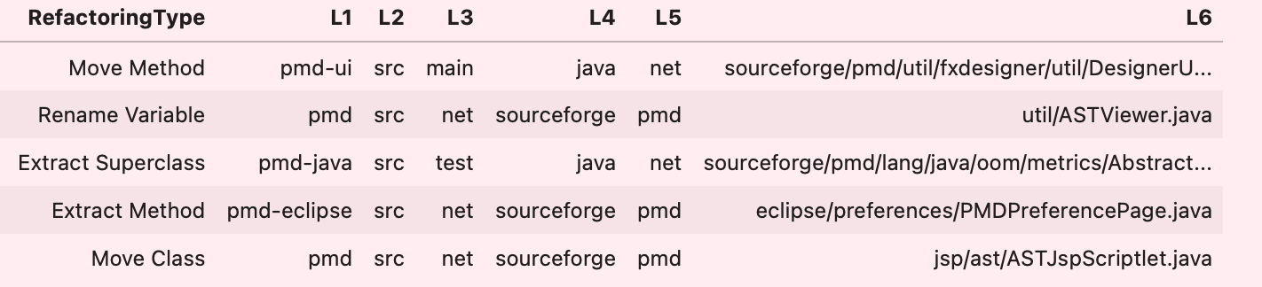
INPUTS
This is a random sample of our feature space. Although the dataset includes the commit message, the only way to make use of this information would be to compare it to the text from an actual refactoring request which were not available.
Splitting the path into 6 features allows the patterns in the hierarchy to be included in the model.

Slide 10
MODELS
 | DESCRIPTION
NAÏVE BAYES | Assumes that the presence of a particular feature in a class is independent of each other feature
J48 DECISION TREE | Divide the data into ranges based on the attribute values found in the training sample
RANDOM FOREST | A large number of individual uncorrelated decisions trees all vote on the outcome and the probability of the class corresponds to the number of votes each class gets

Slide 11
PREDICTION
We formulated our approach as a classification problem rather than a ranking problem. Our response was a 4-level committer group based on the historical commit frequency defined in the table below:
Adangle/PMD | hibernate | Committer Group
6 | 3 | Extremely High Committers (authors with >400 commits)
9 | 3 | High Committers (authors with 100-400 commits)
8 | 4 | Medium Committers (authors with 50-200 commits)
54 | 12 | Low Committers (authors with <50 commits)

Slide 12
Why Classification?
Simple to implement
Simple to interpret
Ranking assumes a fixed effectiveness hierarchy of “best” to “worst” refactor candidates. Classification uses a looser assumption: groups (not individuals) form an effectiveness hierarchy.
Assumption of each committer group having similar effectiveness is likely to be more realistic than underlying ranking assumption.
Best Performing Model
As shown on the next couple slides, Random Forest clearly outperformed the Naïve Bayes and J48 Decision Tree models in both the majority (extremely high) and the minority (low) classes based on the shapes of the ROC and PR curves from the adangle/PMD project.

Slide 13
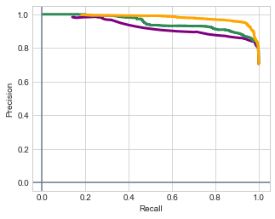
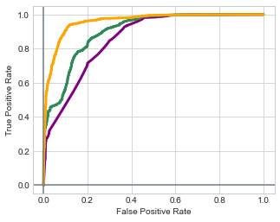
Model Selection RESULTS (Extremely High Group)
Precision and Recall
Receiver Operating Characteristic
Random Forest
Naïve Bayes
J48 Decision Tree

Slide 14
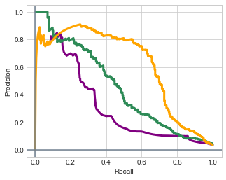
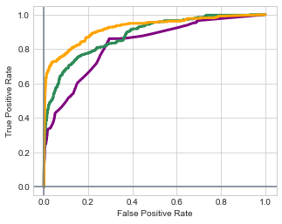
Model Selection RESULTS (Low Group)
Precision and Recall
Receiver Operating Characteristic
Random Forest
Naïve Bayes
J48 Decision Tree

Slide 15
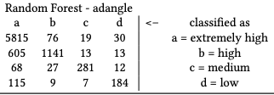
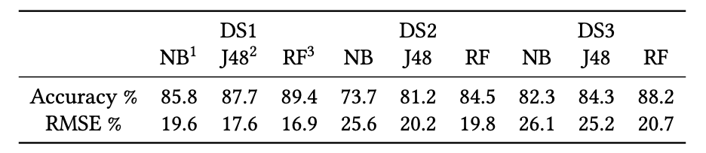
CONFUSION MATRIX
Redoing Cost – should be done by ex high but was not
Assumption:
Cost (misassigning ex high to low) > Cost (misassigning low to ex high)
In other words: Redoing Cost > Experience Cost
Experience Cost – should not be done by lower groups, but was not

Slide 16
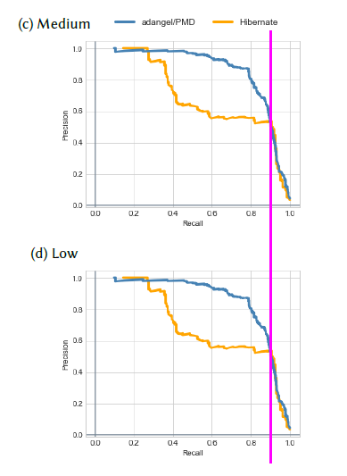
Improving Low Group Recall
Why improve the recall of low group?
recall = proportion of actual positive correctly classified = (true classified lows) / (actual lows) = (true classified lows) / (true classified low + lows falsely classified as another class) = TP / (TP + FN) where TP=“True Positives”, FN=“False Negatives”
Assuming (Redoing Cost > Experience Cost) is correct, we want to drive up proportion of actual lows.
Possible solutions: over-sample minority class, under-sample majority class, combination of over and under-sampling, Synthetic Minority Over-sampling Technique (SMOTE), threshold adjustment.
Base on van den Goorbergh et. al. (1), threshold adjustment avoids issues that arise when using over or under-sampling techniques.

Slide 17
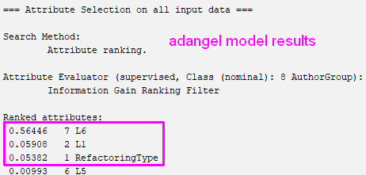
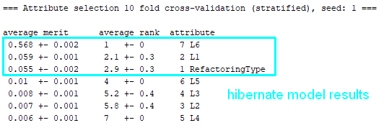
Variable Importance
The top 3 most important variables in the model match our intuition:
The last part of the file path (L6) most unique part of the file being committed.
Other elements of the file path (L1 – L5) repeat far more often and contain less information about the file.
L1 is the first part of the file descriptor which implies the model is making the most use of the first and last parts of the file path
Refactoring type is close in importance as L1, but there is large drop RefactoringType to L5.

Slide 18
THREATS TO VALIDITY
Due to our small feature space, if the low committers and the high committers are working on similar files, the model will have a difficult time distinguishing between the classes.
We can at least partially explain the degradation in performance of the hibernate low and medium groups vs. adangle this way.
Commit frequency may not accurately reflect ability to do a refactor
A low committer may have low commit counts for a particular project, but may be more capable because they have experience on other projects that our data is not reflecting.

Slide 19
Effect of Overlapping Commits
Files committed by extremely high committer group
Files committee by low committer group
Files committed by extremely high committer group
LOW overlap desirable: Model can better learn difference from files
(e.g. adangle project)
HIGH overlap undesirable: Model can not learn difference from files
(e.g. hibernate project)

Slide 20
Testing Commit Files Overlap
The table below shows significantly more overlap in low vs. extremely high and medium vs. extremely high committed files:
Commit Group | low files committed by ex high | Total committed files | proportion of total | P-value, H01: p_{low, ada} = p_{low, hib} H02: p_{med, ada} = p_{med, hib}
adangle – low | 115 | 315 | 0.3651
hibernate – low | 43 | 63 | 0.6825 | 3.039e-06
adangle – medium | 96 | 388 | 0.2474
hibernate – medium | 78 | 183 | 0.4262 | 1.146e-05
HA1: p_{low, ada} < p_{low, hib}
HA2: p_{med, ada} < p_{med, hib}

Slide 21
Final Steps
Top 3 - predictor model
References
van den Goorbergh R, van Smeden M, Timmerman D, Van Calster B The harm of class imbalance corrections for risk prediction models: Illustration and simulation using logistic regression
[https://arxiv.org/pdf/2202.09101]

Slide 22
Questions? THANKS

